Slide 1

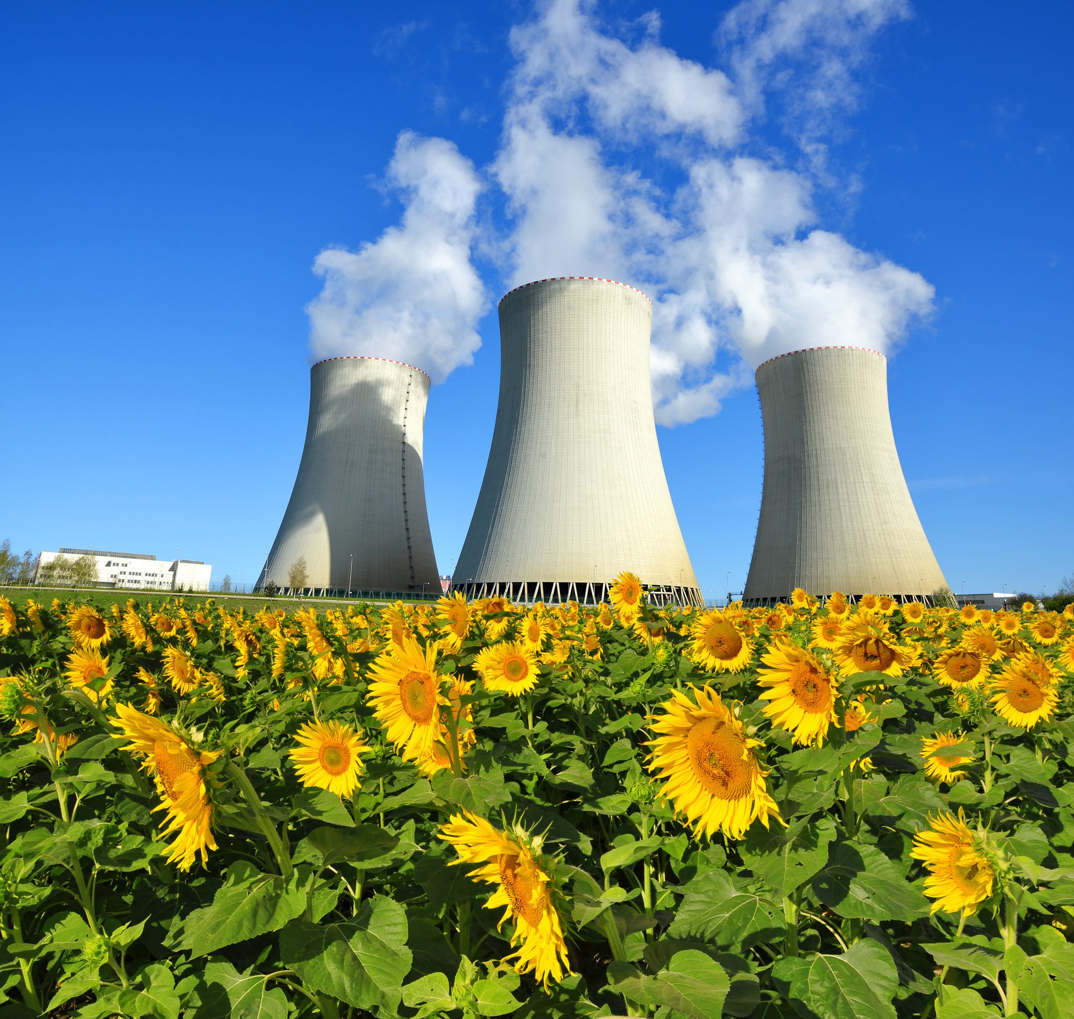

MODELING INSTITUTIONAL RISK AND THE COST OF NUCLEAR POWER
645 – Computational Economics
December 16, 2025
Tyler Linnebur
1

Slide 2
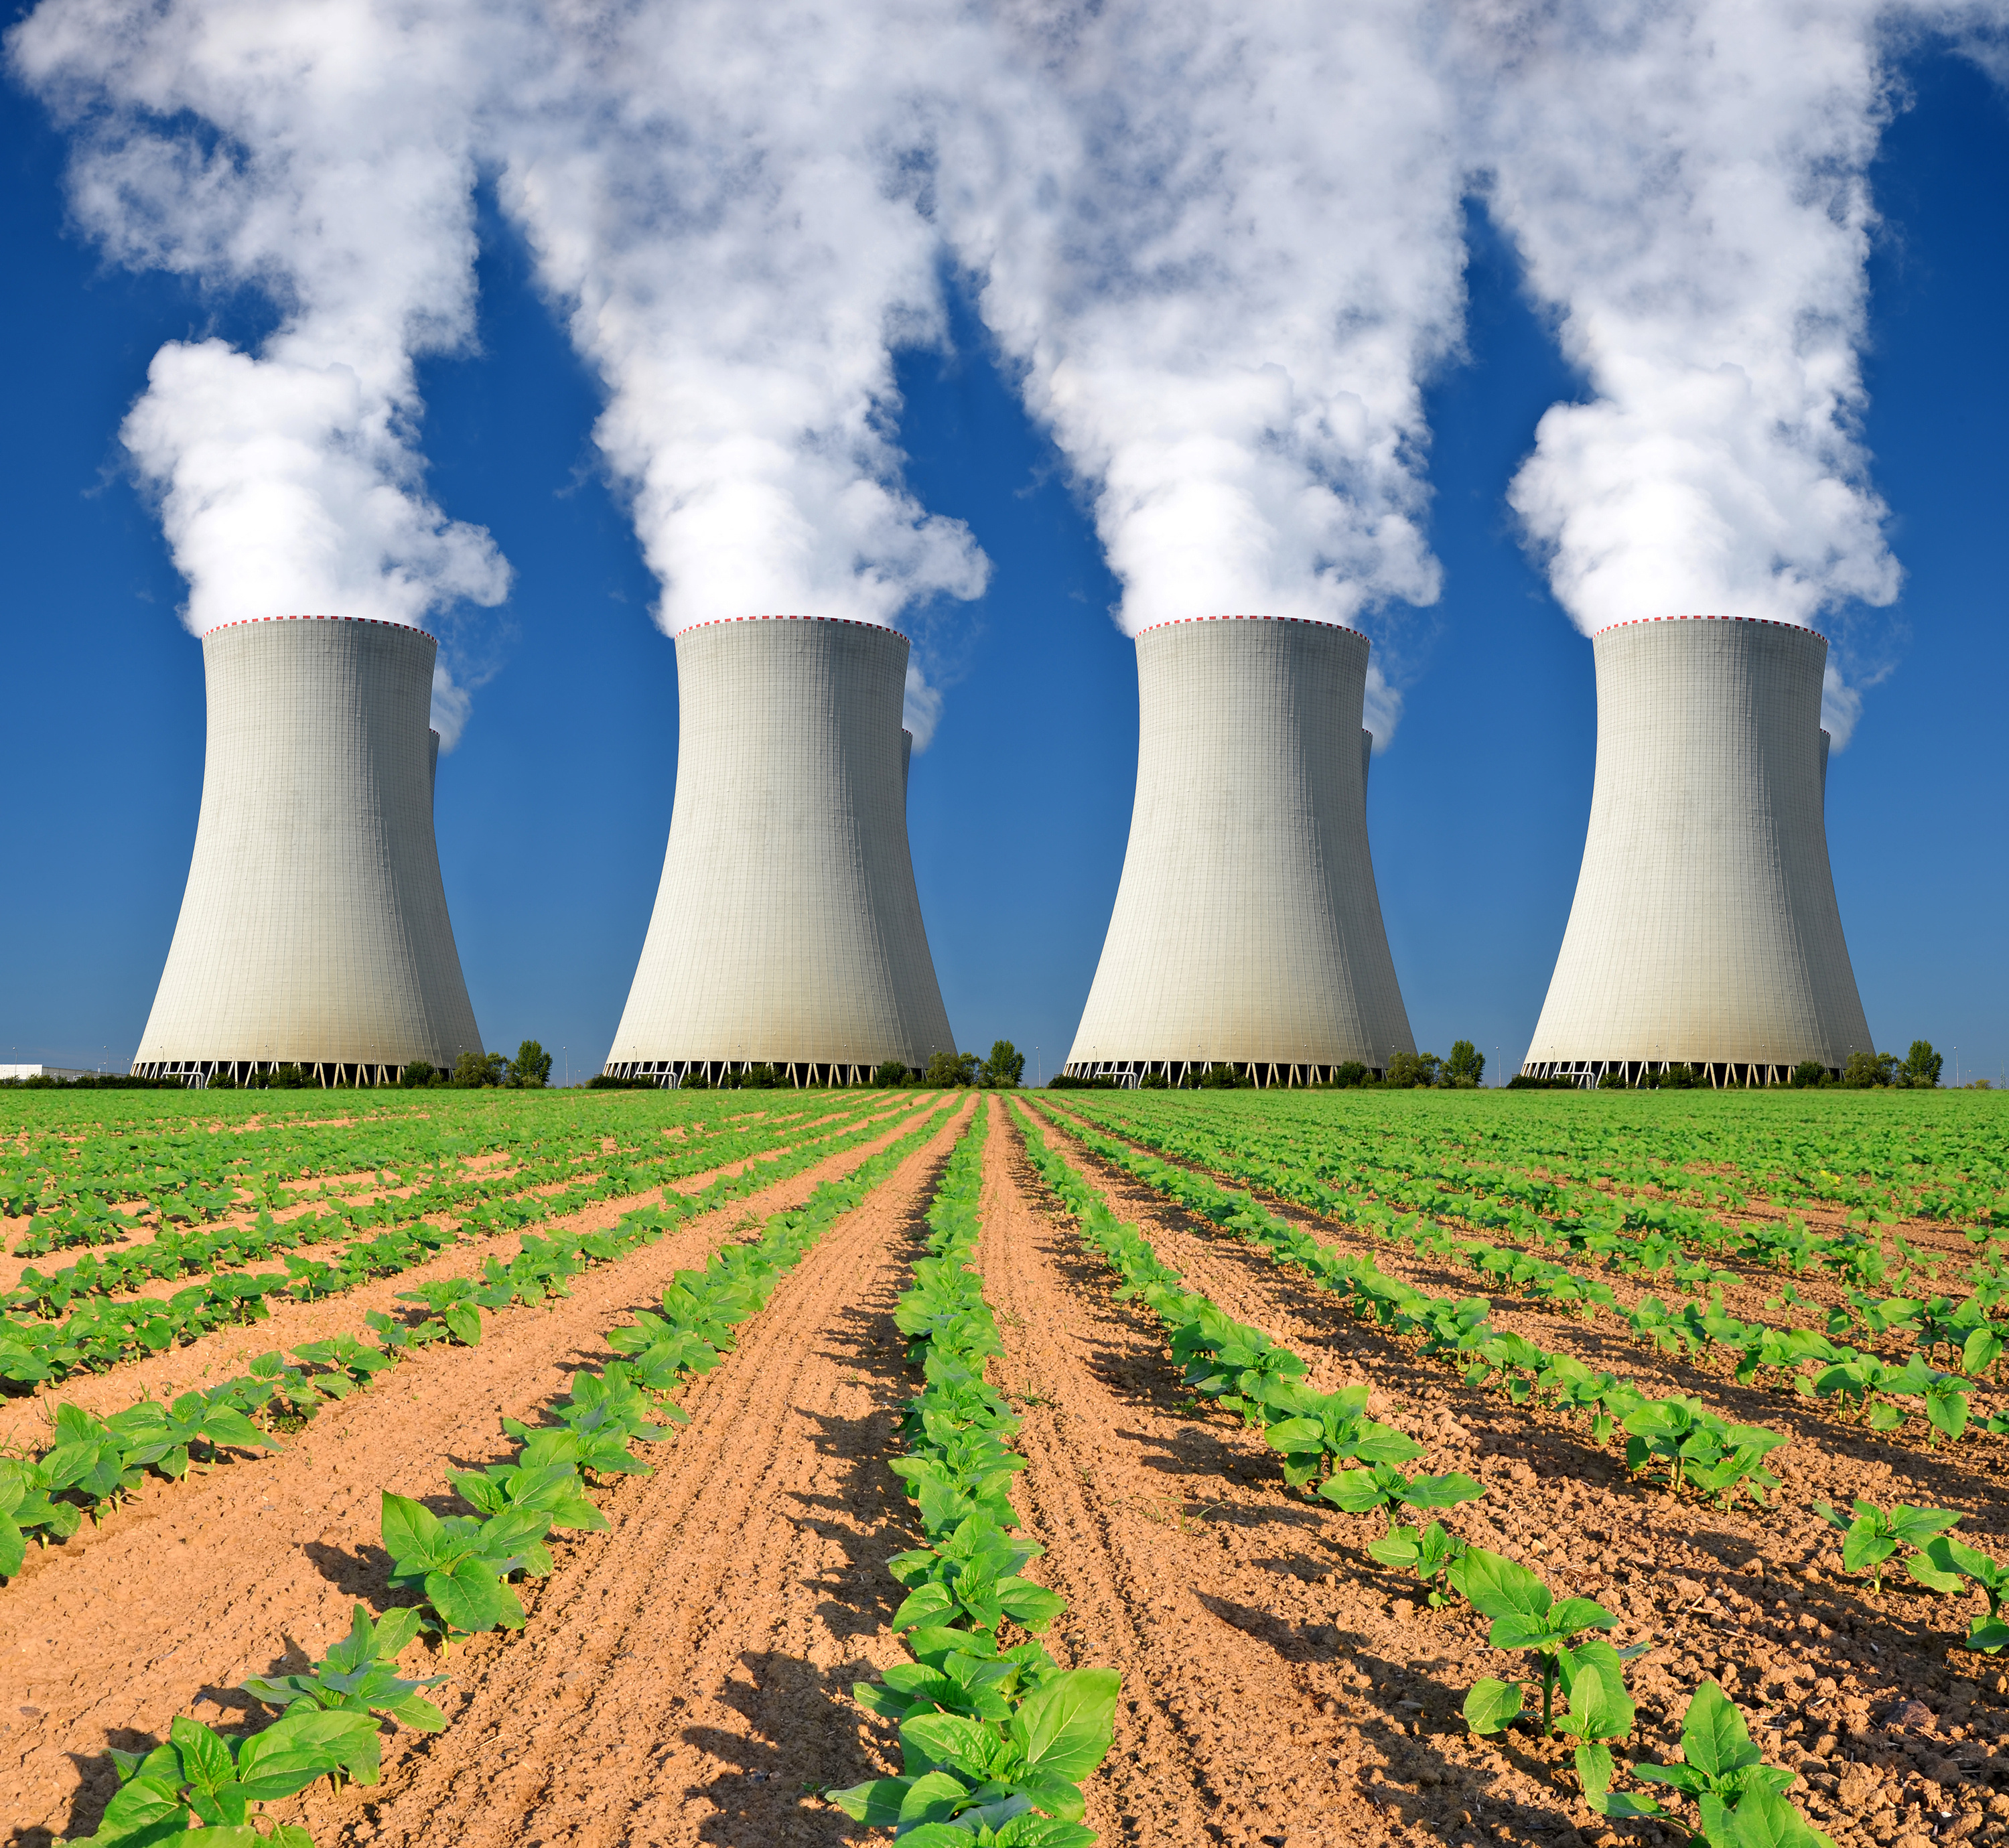

What This Presentation Covers
01
Research Question & Motivation
05
Difficulties & Results
02
Methods
06
If I had a Magic Wand
03
Methods
07
Conclusion
04
Data Sources/ Assumptions
2

Slide 3
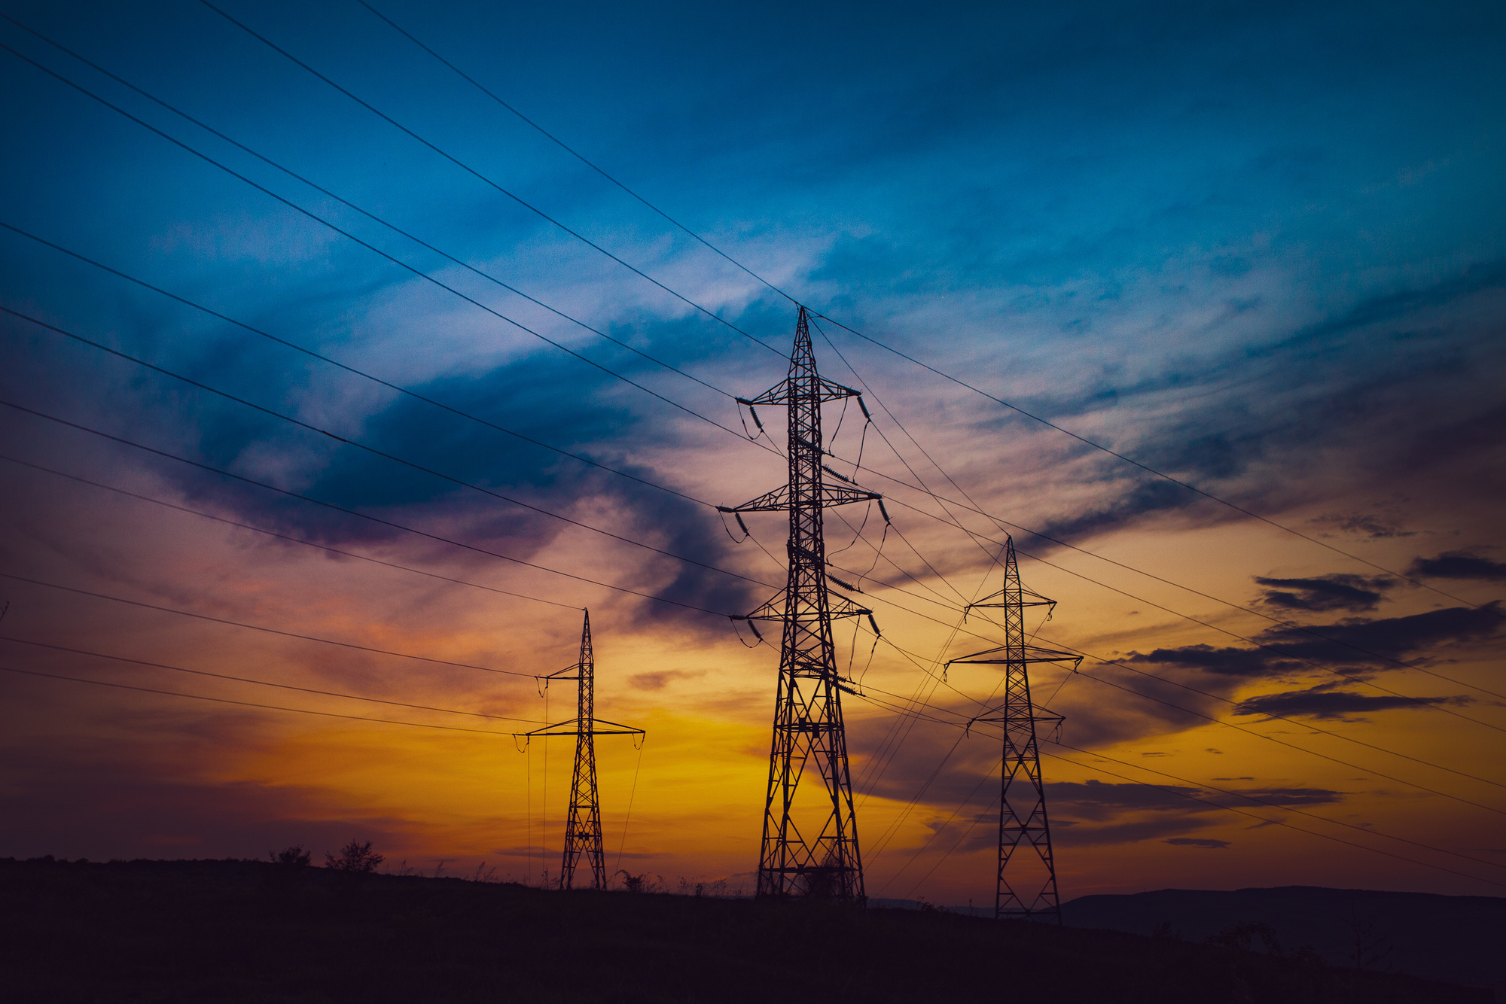
Research Question & Motivation
How do permitting regimes and ownership structures affect nuclear power costs once construction duration and schedule risk are explicitly priced into financing?
Why this matters:
Nuclear is essential for firm, low-carbon electricity and deep decarbonization
Yet new nuclear is widely viewed as uneconomic based on standard Levelized Cost of Energy (LCOE) comparisons
Empirical evidence shows construction duration dominates cost outcomes
Long and uncertain timelines sharply increase financing costs
Standard LCOE models treat construction time as fixed and ignore risk pricing
3

Slide 4
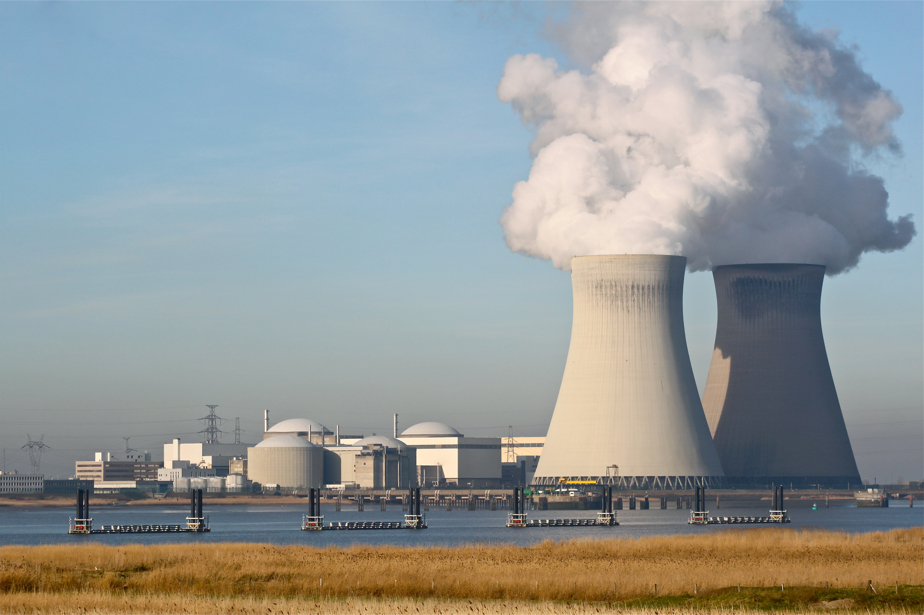
Methods - Model Components
Sets / Indices
Variables
Ownership type: private, public
Permitting regime: baseline, reform → Defines the four institutional cases being compared
x(o,r): weight placed on each ownership–permitting case
Z: selected levelized cost of electricity (LCOE)
Parameters
Objective Function
Engineering and cost inputs (held constant):
Capital cost, O&M cost, fuel cost (from OECD-NEA)
Financing inputs:
Base WACC by ownership
Construction duration by permitting regime
Schedule risk (dispersion of construction time)
Risk pricing parameter:
Converts schedule uncertainty into higher financing cost
Minimize total LCOE across cases
Optimization selects the lowest-cost ownership–permitting combination
Constraints
Weights across cases must sum to one
All weights must be nonnegative → Forces selection of exactly one institutional configuration
4
Notes:
- x(o,r) is a switch that turns on the cheapest case. Part of the linear program
- Z is the objective value of the model. represents the chosen levelized cost of electricity, in dollars per megawatt-hour, after the model selects the lowest-cost case.

Slide 5
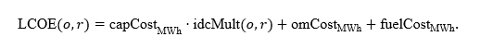
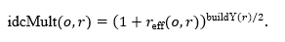
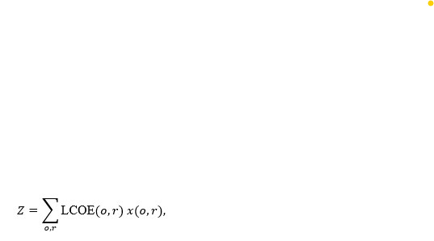
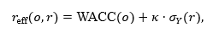
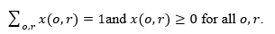
Methods - Cost Formation & Selection
Cost minimization:
Interest during construction (IDC):
Only capital costs adjust for construction risk
O&M and fuel costs held constant
Optimization selects the lowest-cost ownership–permitting combination
No behavioral assumptions, just transparent comparison
Capital is tied up for years before revenue begins
Longer builds and higher discount rates compound financing costs
Midpoint compounding approximates spending over construction
Objective Function
Effective discount rate (risk pricing):
Selection Constraints
Base WACC differs by ownership
Schedule risk, measured as dispersion in construction time, raises required returns
Investors price uncertainty ex ante, not just realized delays
κ is a calibration parameter
Forces the model to choose exactly one ownership–permitting configuration
Selects the minimum LCOE across ownership and permitting cases
5

Slide 6
Data Sources/ Assumptions
Reactor-level construction data from the International Atomic Energy Agency, Power Reactor Information System (IAEA PRIS)
Cost inputs:
OECD-NEA LCOE tables (capital, O&M, fuel)
Plant Type: LWR (1100 MW)
Construction start to commercial operation
Cancelled and incomplete units excluded
Compared 10 plants for baseline and reform groups
Financing assumptions obtained from OECD NEC literature:
Two empirical cohorts:
Baseline permitting:
Long average build times - 14.92 years
Very high dispersion - 10.36 years
Reformed permitting:
Shorter builds - 6.44 years
Low dispersion - 0.66 years
Private WACC ≈ 8%
Public WACC ≈ 2.5%
6

Slide 7
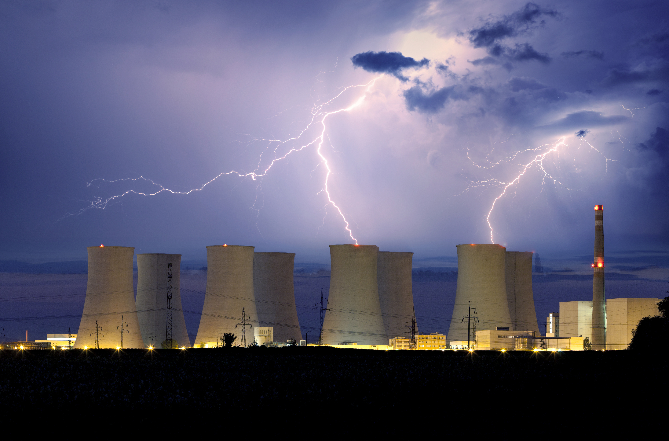
Difficulties & Results
Formulation Difficulties
Results
Nuclear projects are rare and heterogeneous
Construction delays are institutional, not random
Investors price risk, not just expected duration
Need a tractable proxy for schedule uncertainty
Tradeoff between realism and transparency
Deterministic structure chosen to make mechanisms obvious
Permitting reform has a first-order effect on LCOE
Reduction in schedule risk matters more than average build time
Financing effects dominate all other cost components
Ownership matters, but conditionally:
Public ownership lowers costs only when permitting is predictable
Under baseline permitting, high risk overwhelms financing advantages
Lowest-cost case:
Public ownership + reformed permitting (~$76/MWh)
Highest-cost case:
Private ownership + baseline permitting
7

Slide 8
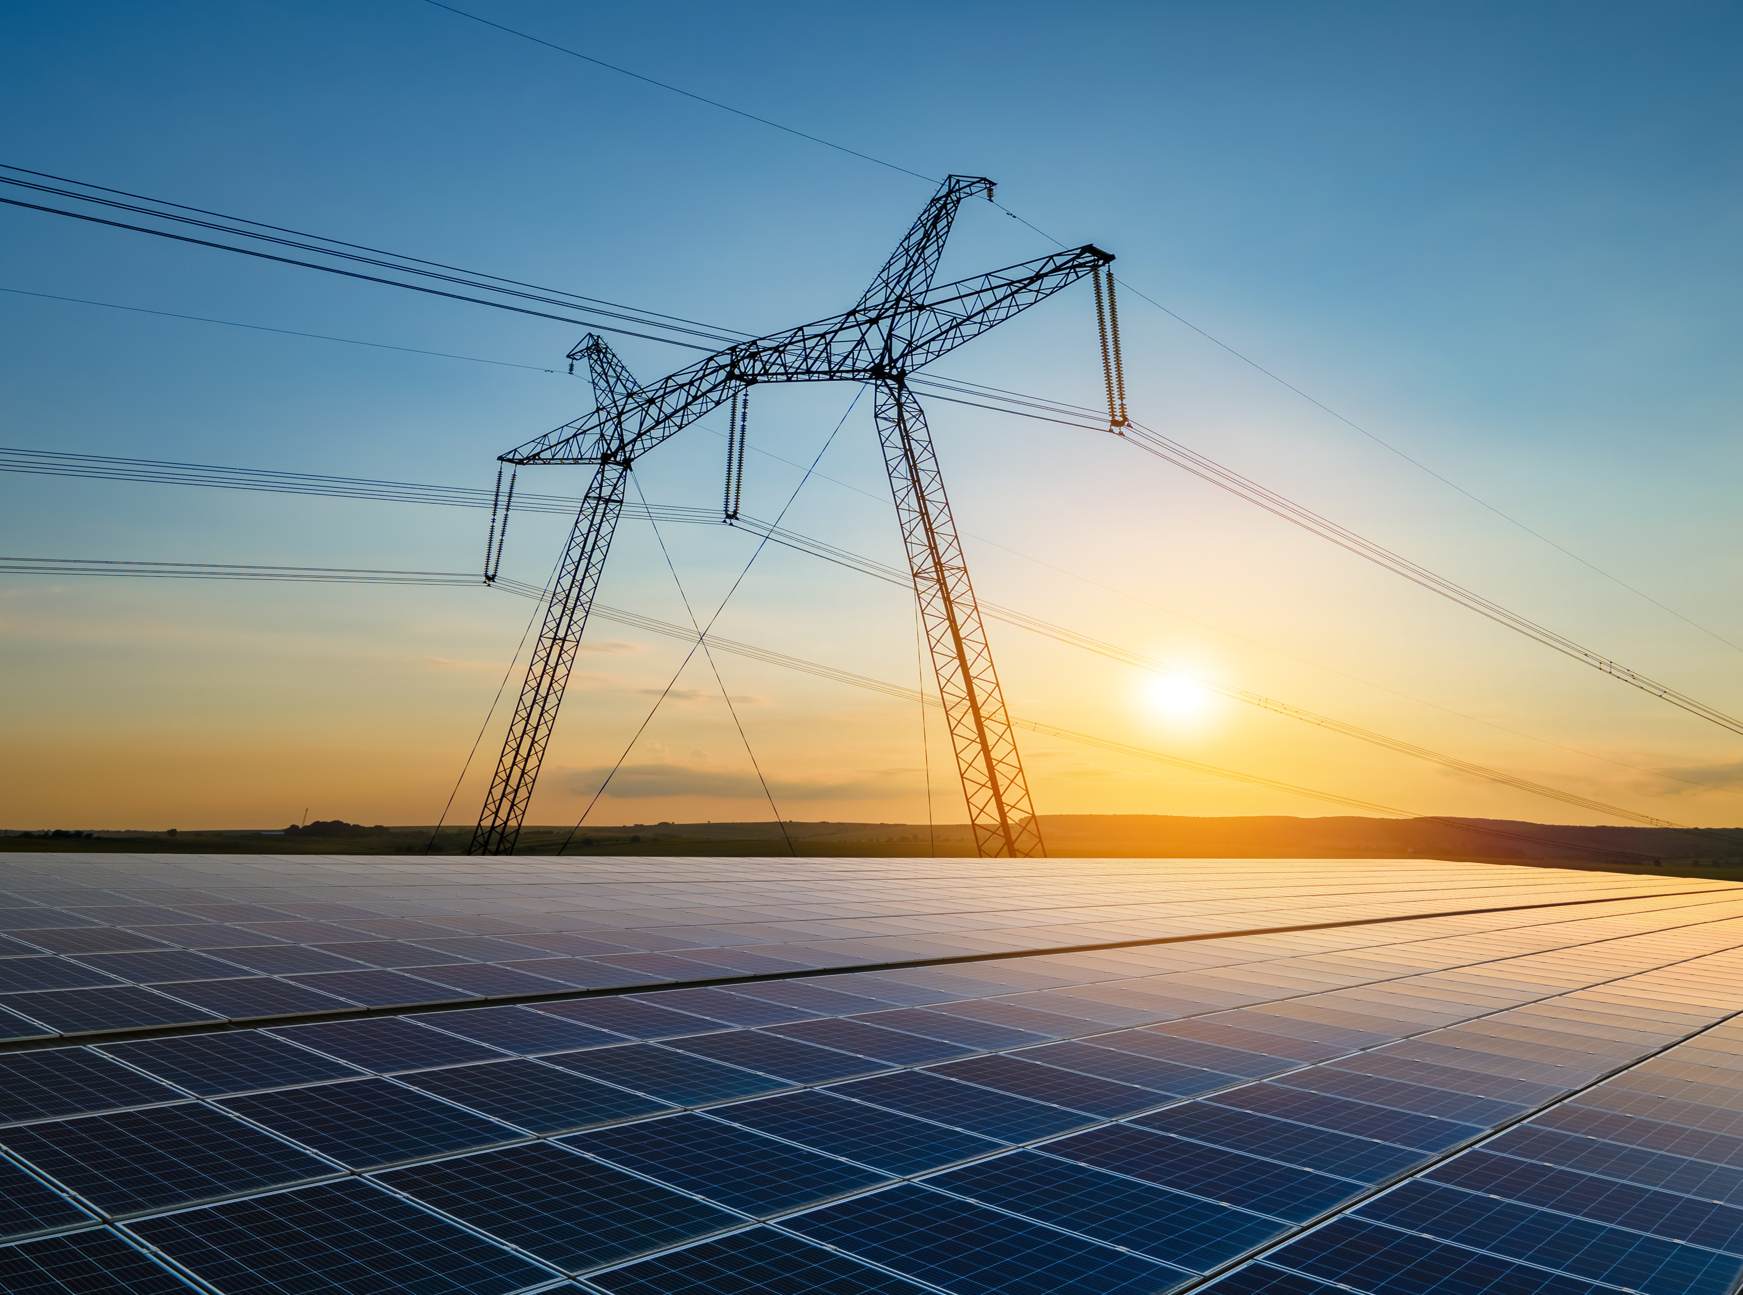
If I had a Magic Wand
If I Had Unlimited Time, Money, Energy
Move from deterministic to stochastic construction timelines
Model full cash flows during construction and operation
Endogenize investment timing and option value
Compare regulatory regimes across countries explicitly
Model RAB, CWIP, loan guarantees, and risk-sharing instruments
Embed this framework into a power system expansion model
8

Slide 9
Conclusion
Nuclear cost problems are fundamentally institutional risk problems
Regulatory predictability matters more than speed alone
Ownership structure is secondary to permitting coherence
Standard LCOE comparisons overstate inherent nuclear cost
Policy debates focusing only on technology or subsidies miss the main drive
9

Slide 10
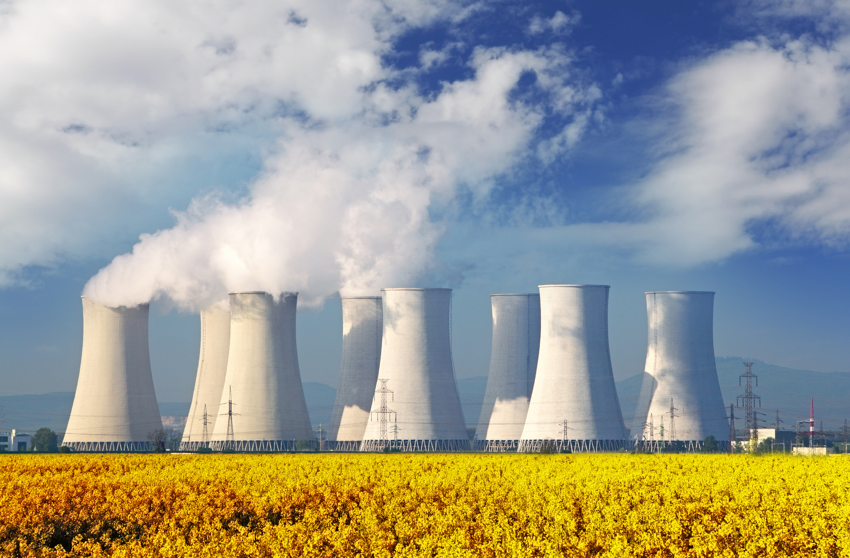
THANK YOU
10

Slide 11
Refereces
Bowen, M., Evans, A., Khan, H., & Ponangi, R. T. (2024). Reforming nuclear reactor permitting and environmental reviews: Roundtable report. Columbia University, Center on Global Energy Policy. https://www.energypolicy.columbia.edu
Foster, J., Wagner, L., & Bratanova, A. (2014). LCOE models: A comparison of the theoretical frameworks and key assumptions (No. 4-2014). School of Economics, University of Queensland, Australia.
Grubler, A. (2010). The costs of the French nuclear scale-up: A case of negative learning by doing. Energy Policy, 38(9), 5174–5188.
Guaita, N., Spangler, R. M., & Hansen, J. (2025). Parametric and nonparametric models of U.S. cost overruns for nuclear power plants (INL/CON-25-84516-Revision-0). Idaho National Laboratory. https://www.inl.gov
International Atomic Energy Agency. (n.d.). PRIS Country Details: China. Power Reactor Information System. https://pris.iaea.org/PRIS/CountryStatistics/CountryDetails.aspx?current=CN
International Atomic Energy Agency. (n.d.). PRIS Country Details: Republic of Korea. Power Reactor Information System. https://pris.iaea.org/PRIS/CountryStatistics/CountryDetails.aspx?current=KR
International Atomic Energy Agency. (n.d.). PRIS Country Details: United States of America. Power Reactor Information System. https://pris.iaea.org/PRIS/CountryStatistics/CountryDetails.aspx?current=US
Jacobs, J., Jantarasami, L., & Fishman, X. (2024, January). Licensing and permitting reforms to accelerate nuclear energy deployment. Bipartisan Policy Center.
Lovering, J., Yip, A., & Nordhaus, T. (2016). Historical construction costs of global nuclear reactors. Energy Policy.
Lovering, J. R., Nordhaus, T., & Yip, A. (2017). Apples and oranges: Comparing nuclear construction costs across nations, time periods, and technologies. Energy Policy, 102, 650–654.
Nuclear Innovation Alliance. (2024). Key recommendations for reforming U.S. nuclear energy regulation. Washington, DC: Nuclear Innovation Alliance.
OECD-NEA. (2021). Unlocking reductions in the construction costs of nuclear: A practical guide for stakeholders (NEA No. 7530). OECD Publishing.
OECD-NEA. (n.d.). Levelised cost of electricity calculator. https://www.oecd-nea.org/lcoe/
OECD-NEA. (2022). Financing new nuclear power plants: Minimising the cost of capital by optimising risk management (NEA No. 7632). OECD Publishing. https://www.oecd-nea.org
Portugal-Pereira, J., Ferreira, P., Cunha, J., Szkló, A., Schaeffer, R., & Araújo, M. (2018). Better late than never, but never late is better: Risk assessment of nuclear power construction projects. Energy Policy, 120, 158–166.
U.S. Energy Information Administration. (n.d.). How much electricity in the United States is generated from nuclear? U.S. Department of Energy. https://www.eia.gov/tools/faqs/faq.php?id=228&t=3
U.S. Energy Information Administration. (2022, November 18). Nuclear explained: Data and statistics. U.S. Department of Energy. https://www.eia.gov/energyexplained/nuclear/data-and-statistics.php

